Slide 1
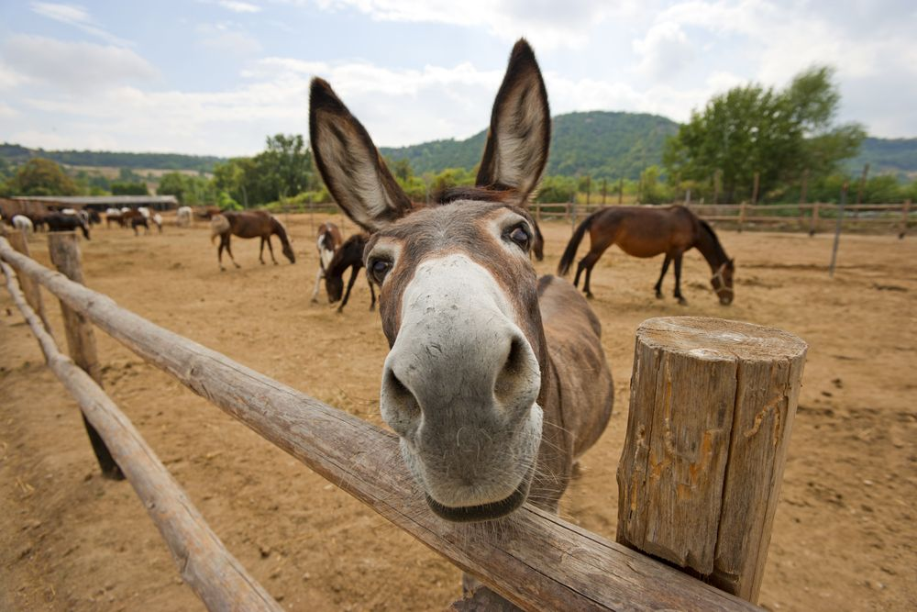
Weighing Donkeys
Michelle Manning

Slide 2
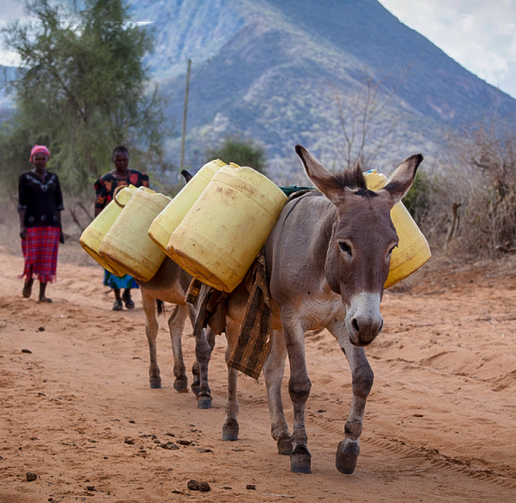
Introduction
Donkeys are valuable to farmers:
Transport goods & building materials
Ferry people
Plough crops
When sick, the right amount of medicine is key & depends on the donkey’s weight
This needs to be assessed in the field without having to haul an equine scale into hard-to-access places
These researchers decided to test whether the correlation between volume and circumference could help solve this issue

Slide 3
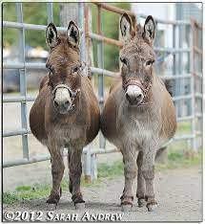
Methods
Nomograms - a graphical calculating device to allow the approximate graphical computation of a mathematical function
Used to predict weight with tape measurements
“In mathematical terms, a donkey is basically an elliptical cylinder with appendages.”
Data for 544 donkeys from 17 different sites in Kenya
Factors Explored:
Measurements: Liveweight, heart girth (circumference behind front legs), height, length
Body Condition Score (BCS)
Age
Sex
Notes:
Therefore, we expect its weight to be approximately proportional to Girth2 × Length.

Slide 4
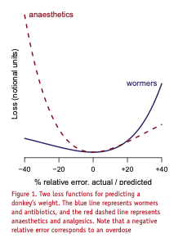
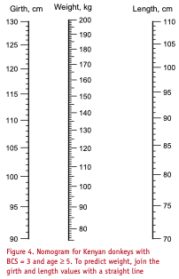
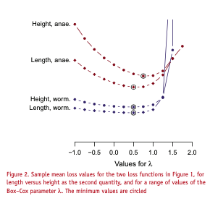
Model Selection
Which nomogram?
Parallel-scale
Pros: 2 parameters, easy application and training, scales well
Cons: not as sophisticated
Which measurements?
There is a risk to overdosing or underdosing certain medications
Length vs Height

Slide 5
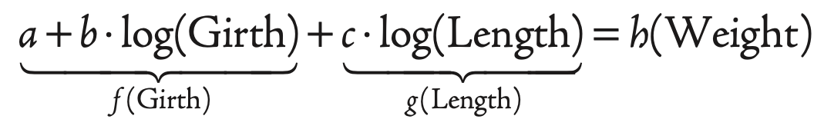
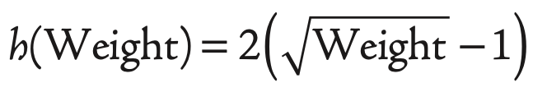
Model
Initial Model had length & height be interchangeable
Final Model
Only uses length
Weight is redefined to account for it
Adjusts the reference point to BCS = 3, Age >= 5

Slide 6
Recreation of the Model
Regression Model in R:
lm3 <- lm(wght ~ log(girth) + log(length) + ageGroup + BCSc, donkey4)
Recode Age into groups
Recenter reference for Age & BCS
Code h(Weight) into optimal form
Check Box-Cox Power Transformation
Final Model:
-100.9 + 18.4 log(Girth) + 7.7 log(Length) + ageGroup + BCSc = 2(sqrt(Weight)-1)

Slide 7
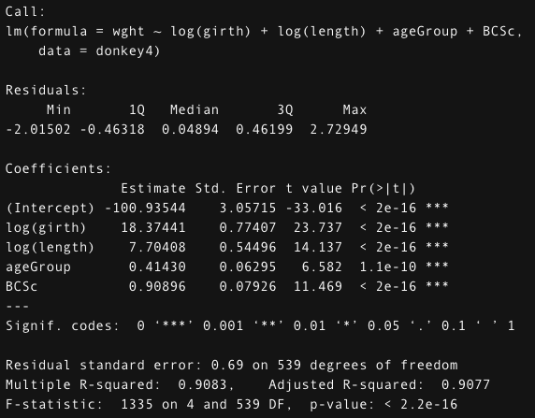
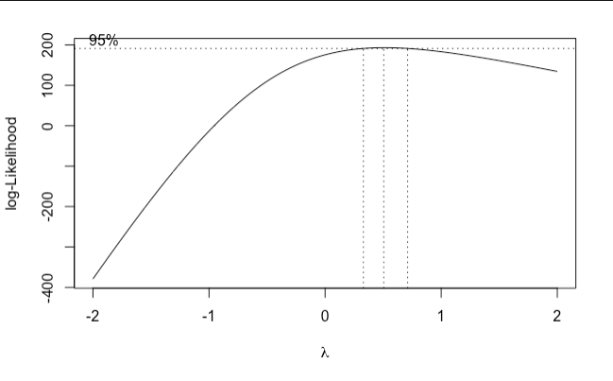
Recreation of the Model Cont.

Slide 8
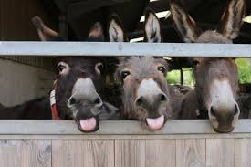
Conclusions
An accurate, yet simple measure of weight is vital to vet care in the field
Used a least-squares regression to figure out what factors contributed to accuracy, particularly, length or height.
A parallel-scale nomogram that implements length is the best answer to this need
Applied the model to the nomogram and now we have simple and easy way to treat

